Slide 1



Microsoft .NET
Course of
Software Engineering 2
A.A. 2001-2002
A introduction
to the new set of
Microsoft software technologies
Presented by:
Fabio Rossi
1997s022@educ.disi.unige.it

Slide 2
Contents
.NET History
What is .NET?
.NET goals
Basic elements
Five services
Example: The Hospital and the Doctor
.NET versus J2EE
Conclusion
References

Slide 3
.NET History
COM
DCOM
1993
COM +
MTS
1997
.NET
1999
Notes:
Parabola del west

Slide 4
What is .NET?
Idea:
Web as a collaborative environment.
More automated, voice-activated, anywhere, anytime Web environment.
1/3

Slide 5
What Is .NET?
A set of services and technologies (an infrastructure) that will enable a programmable, next generation Internet.
A complete remake of the company’s entire product line.
2/3

Slide 6

What Is .NET?
software integration through the use of XML Web services.
small, discrete, building-block applications that connect to each other—as well as to other, larger applications—via the Internet.
3/3

Slide 7
XML Web Services
XML Web Services allow applications to communicate and share data over the internet, regardless of operating system or programming language.
Defined through public standards organization such as the W3C.

Slide 8
.NET goals
Cross-platform interoperability
Multi-language support
Code reuse
Automatic resource management
Type safety
Debugging
Error handling
Elimination of DLL hell
Security

Slide 9
Interoperability
Examples
A routine written in a language L1 may call another routine written in a different language L2.
A module in L1 may declare a variable whose type is a class declared in L2, and then call the corresponding L2 routines on that variable.
If both languages are object oriented, a class in L1 can inherit from a class in L2.
Exceptions triggered by a routine written in L1 and not handled on the L1 side will be passed to the caller, which—if written in L2—will process it using L2's own exception-handling mechanism.

Slide 10
Multi-language support
The .NET platform supports many programming languages. A new compiler must be implemented for each language.
Programmers do not need to be retrained in a completely new language in order to gain the benefits of .NET.

Slide 11
Code Reuse
Apps do not need to be rewritten in a completely new language in order to gain the benefits of .NET.
For example all the billions of lines of COBOL code with some porting effort, could become useable within the .NET environment.

Slide 12
Automatic resource management
No need to allocate memory
No need to deallocate memory
  Garbage collector
the runtime automatically handles object layout and manages references to objects, releasing them when they are no longer being used. This automatic memory management resolves the two most common application errors, memory leaks and invalid memory references.

Slide 13
Type safety
Every data structure in all .NET supported languages has the same layout.
This means that some code can consume types and instances declared in other languages.

Slide 14
Debugging
During a debugging session, you may move freely and seamlessly across modules written in L1 and L2.

Slide 15
Error handling
.NET provides structured exception handling, similar to that in C++ or Java, as a fundamental feature available to all languages.
This architecture solves many of the problems that have dogged error handling in the past.

Slide 16
DLL hell
Maintaining a Windows PC is a chore, because applications are quite complex. They consist of many files, registry entries, shortcuts, and so on.
Different applications can share certain DLLs, and installing a new application can overwrite a DLL an existing application depends on, possibly breaking an old application (“DLL hell”).
Removing an application is complex and is often imperfectly done.

Slide 17
DLL
Stands for “Dynamic Link Library”.
Pieces of code that apps could take runtime.

Slide 18
Security
Managed components are awarded varying degrees of trust, depending on a number of factors that include their origin (such as the Internet, enterprise network, or local computer).
This means that a managed component might or might not be able to perform file-access operations, registry-access operations, or other sensitive functions.
1/2

Slide 19
Security
The runtime enforces code security.
For example, users can trust that an executable embedded in a Web page can play an animation on screen or sing a song, but cannot access their personal data, file system, or network.
The security features of the runtime thus enable legitimate Internet-deployed software to be exceptionally feature rich.
2/2

Slide 20
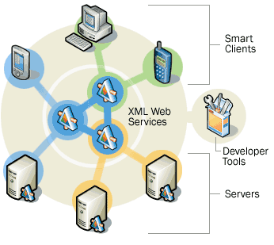
Basic Elements of .NET

Slide 21

Smart Clients
"Smart" client application software and operating systems enable PCs and other smart computing devices to act on XML Web services, allowing anywhere, anytime access to information

Slide 22
Smart Clients
Through Microsoft Windows® XP, Windows XP Embedded, and Windows CE .NET, Microsoft is trying to create the next generation of software clients to enable anytime, anywhere connecting.
The .NET Framework's managed, secure execution environment allows developers to create applications that target the client software of a variety of smart devices.

Slide 23

XML Web Services
A core set XML Web
services that can be
combined with other
XML Web services or
used directly with
smart client
applications.

Slide 24
XML Web Services
XML Web Services allow applications to communicate and share data over the internet, regardless of operating system or programming language.
Defined through public standards organization such as the W3C.

Slide 25

Servers
Microsoft provides server infrastructure
Microsoft Windows® 2000 server family
.NET Enterprise Servers
For deploying, managing, and orchestrating XML Web services

Slide 26
Servers
XML Web services are used through the servers' deep level support of XML.
The .NET platform, by distributing computing power, demands an agile, reliable server infrastructure.
Secure, scalable servers that deeply integrate XML will provide the backbone for hosting and deploying the .NET platform.

Slide 27

Developer Tools
Microsoft Visual Studio .NET is the solution proposed for developers to build and deploy XML Web services.

Slide 28
Developer tools
Program in the Right Language for the Task
Visual Studio .NET provides a single, unified development environment.
Built on the .NET Framework, it provides support for working with XML Web services created in all modern programming languages.
1/3

Slide 29
Developer tools
Transform Applications into XML Web Services
Visual Studio .NET automatically creates the necessary XML and SOAP interface needed to turn an application into a XML Web service.
Developers can concentrate on building the application, not on the plumbing for the XML Web service.
2/3

Slide 30
Developer tools
Reuse Existing XML Web Services
Developing with XML Web services is similar to developing with components.
Visual Studio .NET gives developers the ease of importing XML Web services or using XML Web services hosted remotely.
3/3

Slide 31
SOAP
Simple Object Access Protocol
Lightweight and simple XML-based protocol that is designed to exchange structured and typed information on the Web.
The purpose of SOAP is to enable Web services based on a shared and open infrastructure.
SOAP can be used in combination with a variety of existing Internet protocols and formats including HTTP, SMTP, and MIME

Slide 32
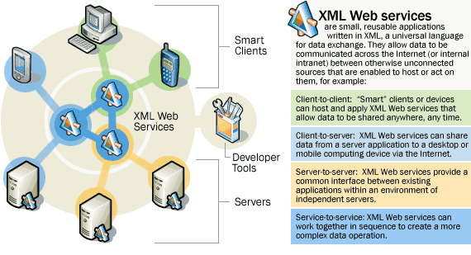
Transition

Slide 33
The 5 Services
Framework .Net
ASP .Net
Web Services
Windows Form
ADO .Net

Slide 34
Framework .Net
The .NET Framework is the programming model of the .NET platform.
It manages much of the plumbing, enabling developers to focus on writing the business logic code for their applications.
1/8

Slide 35
Framework .Net
The .NET Framework includes:
The Common Language Runtime
The Class Libraries.
2/8

Slide 36
The Common Language Runtime
Intermediate Language called
MSIL
(Microsoft Intermediate Language)
CLR: environment for MSIL
JITer (Just in Time compiler)
3/8

Slide 37
The Common Language Runtime
The CLR is responsible for run-time services such as:
Language integration
Security enforcement
Memory
Process
Thread management.
Versioning
4/8
Notes:
Matrici

Slide 38
The Common Language Runtime
Interoperability
How does the interoperability work in practice? The first key idea is to map all software to the .NET Object Model. Once compiled, classes don't reveal their language of origin.
C++
C#
Eiffel
…
Compilers
More…
Object model
Platform
5/8

Slide 39
C#
Language which is equivalent (with the exception of portability) to Java
Available as a programming language within the Visual Studio.NET environment.

Slide 40
Interoperability
Some example of compromise
Eiffel and C++ allow multiple inheritance; the .NET object model (as well as Java, C# and Visual Basic .NET) permits a class to inherit from only one class.
Eiffel and C++ each support a form of genericity (type parameterization): You can declare an Eiffel class as LIST [G] to describe lists of objects of an arbitrary type G without saying what G is; then you can use the class to define types LIST [INTEGER], LIST [EMPLOYEE], or even LIST [LIST [INTEGER]]. C++'s templates pursue a similar goal. This notion is unknown to the .NET object model.
Array in Visual Basic starts from 1, in C from 0
1/2

Slide 41
Interoperability
A solution
On .NET, the name "C++" denotes not one language, but two: Unmanaged and Managed C++.
Classes from both languages can coexist in an application.
Unmanaged classes will compile into ordinary target code (such as Intel machine code), but not to the object model.
As a result, they don't benefit from the Common Language Runtime and lack the seamless interoperability with other languages.
2/2

Slide 42
The Common Language Runtime
Type safety
The runtime enforces code robustness by implementing a strict type- and code-verification infrastructure called the Common Type System (CTS).
The CTS ensures that all managed code is self-describing.
The various Microsoft and third-party language compilers generate managed code that conforms to the CTS.
6/8

Slide 43
The Common Language Runtime
Versioning
.NET introduce a mechanism to obviate to the “DLL hell” problem.
Every app have to specify what DLL use, and what version.
every DLL version needed by apps is host in the system
7/8

Slide 44
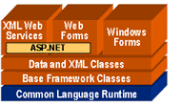
The Class Libraries
Web Forms classes
:
rapid develop of Web GUI applications.
:
develop of lightweight distributed components.
XML Web Services classes
XML classes
:
XML data manipulation and XML translations.
Data classes
:
support persistent data management.
Base classes
:
provide standard
functionality.
8/8

Slide 45
Asp .Net
The new version of ASP
A set of technologies for building Web applications and XML Web Services.
ASP.NET pages execute on the server and generate markup such as XML that is sent to a desktop or mobile browser.
ASP.NET pages use a compiled, event-driven programming model that enables the separation of application logic and user interface.
More…

Slide 46
Asp .Net
ASP use interpreted script code in languages with limited capabilities interspersed with page formatting commands.
ASP.NET code can be written in any NET language, including C#, VB.NET, JScript and C++ with managed extensions.
ASP.NET will automatically detect browser capability. For high-end browsers code processing can be performed on the client. For low-end browsers the server does the processing and generates standard HTML. All this is done transparently to the developer by ASP.NET

Slide 47
ASP
Stands for “Active Server Pages”
Allow programmers to write program logic that dynamically construct the web pages by mixing static HTML and scripting code.
1/3
Notes:
Esempio banca

Slide 48
ASP
CLIENT BROWSER
User types request into browser
Browser renders pages for display to client
2. Browser sends request to server
SERVER
Server locate requested pages and writes it back to client
Page 1
Server delivering
Static Web pages.
Page N
…
2/3
Notes:
Esempio banca

Slide 49
ASP
CLIENT BROWSER
User types request into browser
Browser renders page for display to client
2. Browser sends request to server
SERVER
Server accesses information and generates page containing user’s requested information.
Server dynamically
generating Web pages
based on client input.
3/3
Notes:
Esempio banca

Slide 50
XML Web Services
Cornerstone of the .NET programming model.
Applications access Web Services via ubiquitous Web protocols and data formats with no need to worry about how each Web Service is implemented.
More…
1/2

Slide 51

XML Web Services
Microsoft will distribute a set of default XML web services called “My Services”
2/2

Slide 52
XML Web Services
Web Service is a unit of application logic providing data and services to other applications.
Web Services combine the component-based development and the Web.
1/2

Slide 53
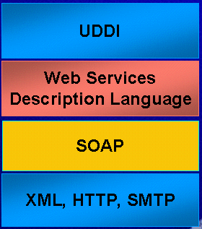
XML Web Services
XML Web Services
It responds to UDDI requests by telling the requestor what service it provides.
The service is defined by the order and the format of the message it processes; these messages are sent and received using the Simple Object Access Protocol (SOAP), and this protocol is built on XML, HTTP, and SMTP.
2/2

Slide 54
Windows Form
Win Forms flow from the System Class Library
  System.WinForms
Similar model to existing VB forms
Different technology from VB forms
Based on class libraries
More…

Slide 55
Windows Form
WF controls have semi-trusted access to a user's computer. This means that binary or natively executing code can access some of the resources on the user's system (such as GUI elements and limited file access) without being able to access or compromise other resources.
Because of code access security, many applications that once needed to be installed on a user's system can now be safely deployed through the Web. Your applications can implement the features of a local application while being deployed like a Web page.

Slide 56
ADO .NET
ADO.NET is an improvement to Microsoft ADO that provides platform interoperability and scalable data access.
Using Extensible Markup Language (XML), ADO.NET can ensure the efficient transfer of data to any application on any platform.
More…
1/2

Slide 57
ADO
Stands for “ActiveX Data Objects”
Microsoft technology for access to remote data via Internet.

Slide 58
ADO .NET
The centerpiece of ADO.NET is the data set.
A data set is an in-memory copy of database data.
A data set constitutes a "disconnected" view of the database data.
It exists in memory without an active connection to a database containing the corresponding tables or views.
1/2

Slide 59
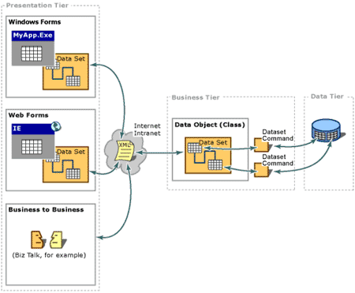
ADO .NET
2/2

Slide 60
ADO .NET characteristic
New data access technology
Designed for disconnected operation
Optimized for data viewing
XML based
Increased flexibility
Increased readability of code
No real change from a developer's perspective.
2/2

Slide 61
Example:
The Hospital and the Doctor
Actors:
The Doctor (D)
  Palmtop
  Cellular phone
The Secretary (S)
  Apple
The Hospital (H)
  PC
XML Web Services:
Call Services:
write in VB
  Calling (for, from)
  Disp (yes/no)
  Other function
SendSMS
write in c#
  Send (who, what)
  Other function

Slide 62
Example:
The Hospital and the Doctor
Initial situation
Doctor
Secretary
Palmtop
WinCE
CLR
CALL
Phone-XML
Apple
MAcOS - CLR
CALL –SendSMS
INTERNET
Hospital
PC
Linux
CLR
CALL

Slide 63
Example:
The Hospital and the Doctor
Hospital need help
Doctor
Secretary
Palmtop
WinCE
CLR
CALL
Phone-XML
Apple
MAcOS - CLR
CALL –SendSMS
INTERNET
Send
(H,msg)
No
Response
CALLING (D,H)
CALLING (D,H)
CALLING
(D,H)
Hospital
Disp(OK)
PC
Linux
CLR
CALL
No
Response
TIMEOUT

Slide 64
.NET vs J2EE
J2EE and .NET are evolutions of existing application server technology used to build enterprise applications.
The earlier versions of these technologies have historically not been used to build web services.
Now that web services has arrived, both camps are repositioning their solutions as platforms that you can also use to build web services.

Slide 65
J2EE
J2EE is an industry standard, and is the result of a large industry initiative led by Sun.
It's important to realize that J2EE is a standard, not a product. You cannot "download" J2EE.
Rather you download a set of Adobe Acrobat PDF files which describe agreements between applications and the containers in which they run. So long as both sides obey the J2EE contracts, applications can be deployed in a variety of container environments.
More…

Slide 66
J2EE
Web Services
J2EE has historically been an architecture for building server-side deployments in the Java programming language. It can be used to build traditional web sites, software components, or packaged applications.
J2EE has recently been extended to include support for building XML-based web services as well. These web services can interoperate with other web services that may or may not have been written to the J2EE standard.
More…

Slide 67
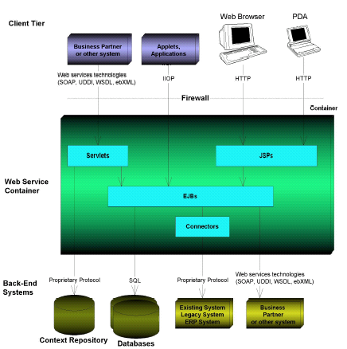
J2EE
Web services

Slide 68
J2EE
The J2EE camp's goal is to give customers choice of vendor products and tools, and to encourage best-of-breed products to emerge through competition. The only way this would ever happen is if the industry as a whole were bought-into J2EE.
To secure buy-in, Sun collaborated with other vendors of eBusiness platforms, such as BEA, IBM, and Oracle, in defining J2EE. Sun then initiated the Java Community Process (JCP) to solicit new ideas to improve J2EE over time.

Slide 69
.NET vs J2EE
The shared vision between both J2EE and .NET is that there is an incredible amount of 'plumbing' that goes into building web services, such as XML interoperability, load-balancing, and transactions.
Rather than writing all that plumbing yourself, you can write an application that runs within a container that provides those tricky services for you.

Slide 70
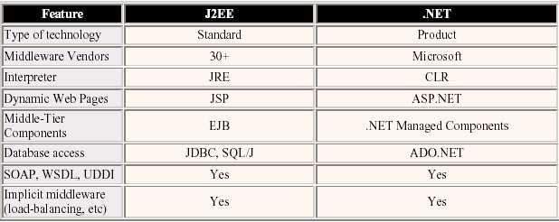
.NET vs J2EE
ANALOGIES

Slide 71
.NET vs J2EE
Time-to-Market Features
Both provide runtime mechanisms that insulate software developers from particular dependencies.
Sun J2EE and Microsoft .NET offer language-level intermediation via the Java Runtime Environment (JRE) and the Common Language Runtime (CLR) respectively.

Slide 72
.NET vs J2EE
Time-to-Market Features – J2EE better than .NET
State management services enable developers to write less code and not worry about managing state, resulting in a higher degree of rapid application development. State management services enable you to build components that hold state.
Persistence services (entity beans) enable developers to write applications without coding data access logic; database-independent applications are easier to build and maintain.

Slide 73
.NET vs J2EE
Time-to-Market Features – .NET better than J2EE
ASP.NET is independent of client device, and allows for user interfaces to be rendered to alternative user interfaces without rewriting code.
Microsoft also offers Queued Components which are superior to MessageDriven Beans.
Microsoft has tried to simplify server-side programming greatly by removing support for features found in traditional enterprise applications, such as stateful servers and simple transactions.
Microsoft also provides business process management and E-Commerce capabilities, which are available in some J2EE implementations but not all.

Slide 74
.NET vs J2EE
Language Support – J2EE
J2EE promotes Java-centric computing, and all components deployed into a J2EE deployment (such as EJB components and servlets) must be written in the Java language.
To use J2EE, you must commit to coding at least some of your eBusiness systems using the Java programming language. Other languages can be bridged into a J2EE solution through web services, CORBA, JNI, or the JCA, however, these languages cannot be intermixed with Java code.
In theory, JVM bytecode is language-neutral, however in practice, this bytecode is only used with Java.

Slide 75
.NET vs J2EE
Language Support – .NET
.NET supports development in any language that Microsoft's tools support due to the new CLR. With the exception of Java, all major languages will be supported.
Microsoft has also recently introduced its new C# language which is equivalent (with the exception of portability) to Java and is also available as a programming language within the Visual Studio.NET environment.
All languages supported by the CLR are interoperable in that all such languages, once translated to IL, are now effectively a “common” language. A single .NET component can therefore be written in several languages.

Slide 76
.NET vs J2EE
Data Access
ADO.NET is built on the premise of XML data interchange (between remote data objects and layers of multi-tier apps) on top of HTTP (SOAP…).
EJB, JDBC, etc. leave the data interchange protocol at the developer's discretion, and operate on top of either HTTP, RMI, etc…

Slide 77
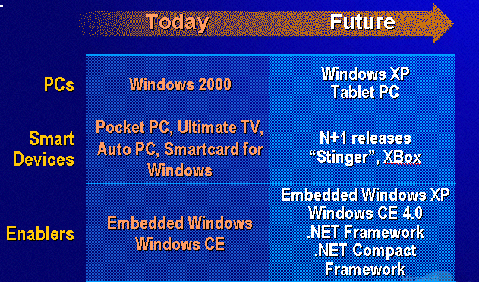
Today and the Future

Slide 78
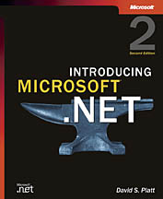
References
The Introduction to .NET and its components
David S. Platt
Introducing Microsoft .NET
Microsoft Press – 2001
The basic elements of .NET and other
www.microsoft.com\net
.NET Framework Resource Management
www.gotdotnet.com
Articles on components and architecture
www.itportal.com
1/2

Slide 79
References
J2EE vs .NET
  java.oreilly.com/news/farley_0800.html
  Chad Wavter and Ed Roman – J2EE vs .NET
  www.middleware-company.com
About Interoperability
www.sdmagazine.com/documents/s=7134/sdm0205j/0205j.htm
2/2

